Slide 1
Plotting matplotlib
Programming And Scripting
Andrew.Beatty@atu.ie

Slide 2
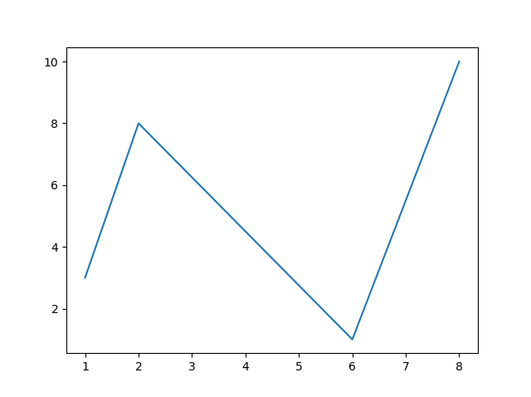
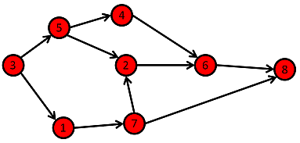
matplotlib
Makes plots
(graphs in computing can mean something else)
You can fall down a long rabbit hole messing with plots
Line plots
Scatter plots
Histograms
Pie charts

Slide 3
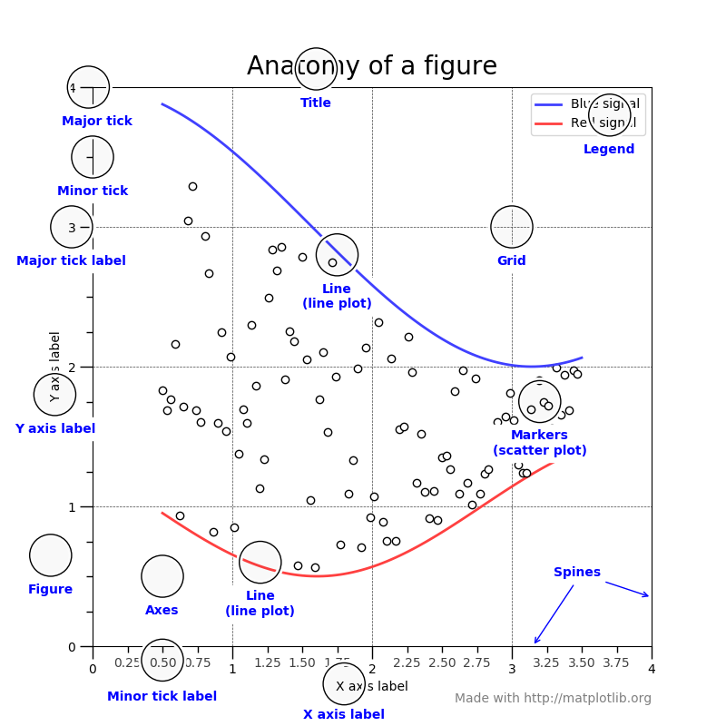

Slide 4
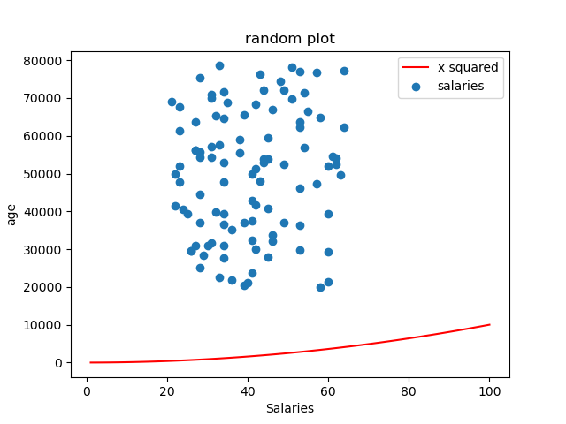

Slide 5
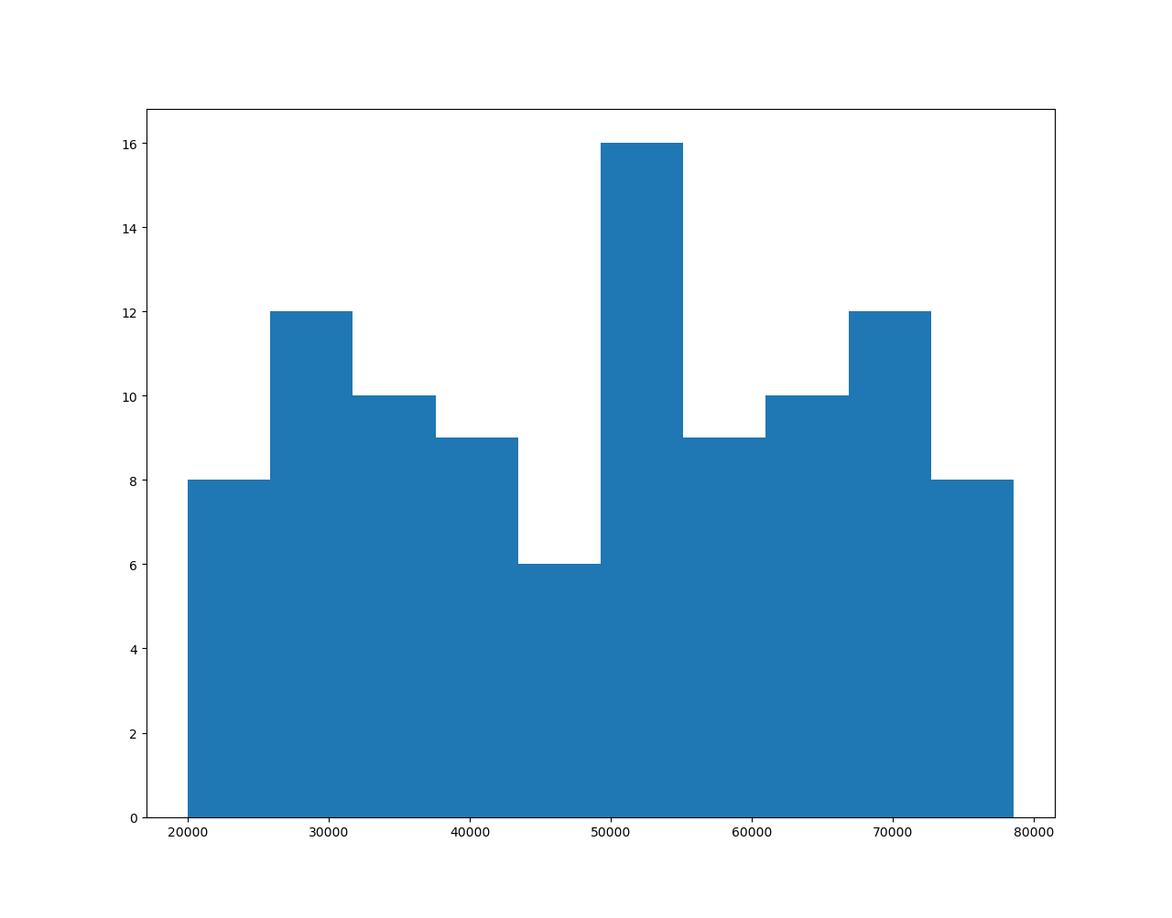

Slide 6
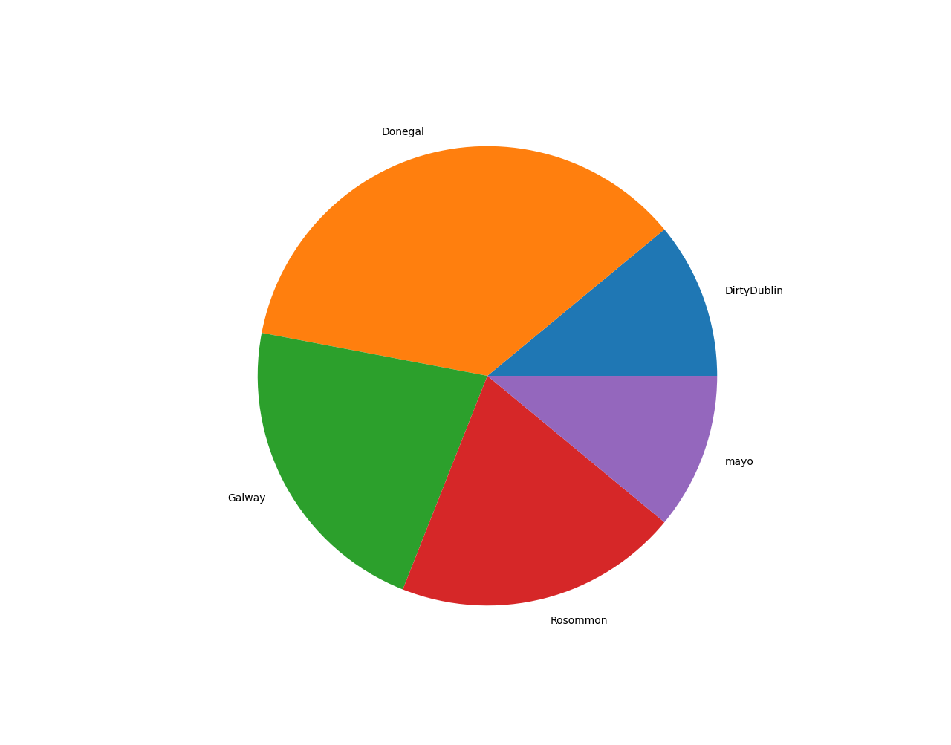

Slide 7
Ok how Do we write the code
Two ways of using matplotlib
Stateful (pyplot) see W3Schools.com
Stateless (Object oriented) a bit more advanced see realpython tutorial

Slide 9
Ok there is a lot of exploring you can do with these

